Slide 1
Outline
Project 1
Hash functions and its application on security
Modern cryptographic hash functions and message digest
  MD5
  SHA

Slide 2
GNU Privacy Guard
Yao Zhao

Slide 3
Introduction of GnuPG
GnuPG Stands for GNU Privacy Guard
A tool for secure communication and data storage
To encrypt data and create digital signatures
Using public-key cryptography
Distributed in almost every Linux
For T-lab machines --- gpg command

Slide 4
Functionality of GnuPG
Generating a new keypair
  gpg -- gen-key
    Key type
      (1) DSA and ElGamal (default)
      (2) DSA (sign only)
      (4) ElGamal (sign and encrypt)
    Key size
      DSA: between 512 and 1024 bits->1024 bits
      ElGamal: any size
    Expiration date: key does not expire
    User ID
    Passphrase

Slide 5
Functionality of GnuPG
Generating a revocation certificate
  gpg --output revoke.asc --gen-revoke yourkey
Exporting a public key
  gpg --output alice.gpg --export alice@cyb.org
  gpg --armor --export alice@cyb.org
Importing a public key
  gpg --import blake.gpg
  gpg --list-keys
  gpg --edit-key blake@cyb.org
    fpr
    sign
    check

Slide 6
Functionality of GnuPG
Encrypting and decrypting documents
  gpg --output doc.gpg --encrypt --recipient blake@cyb.org doc
  gpg --output doc --decypt doc.gpg
Making and verifying signatures
  gpg --output doc.sig --sign doc
  gpg --output doc --decrypt doc.sig
Detached signatures
  gpg --output doc.sig --detach-sig doc
  gpg --verify doc.sig doc

Slide 7
Questions?

Slide 8
Outline
Project 1
Change of class time on 1/30: 4:30-5:50pm ?
Hash functions and its application on security
Modern cryptographic hash functions and message digest
  MD5
  SHA

Slide 9
Hash Functions
Condenses arbitrary message to fixed size
  h = H(M)
Usually assume that the hash function is public and not keyed
Hash used to detect changes to message
Can use in various ways with message
Most often to create a digital signature
Notes:
A variation on the message authentication code is the one-way hash function. As with the message authentication code, a hash function accepts a variable-size message M as input and produces a fixed-size output, referred to as a hash code H(M). Unlike a MAC, a hash code does not use a key but is a function only of the input message. The hash code is also referred to as a message digest or hash value.
Slides from Stallings (first 3)

Slide 10
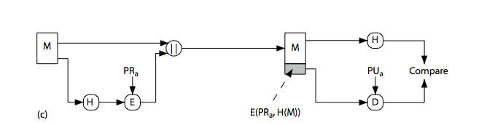
Hash Functions & Digital Signatures
Notes:
Stallings Figure 11.5c “Basic Uses of Hash Functions” shows the hash being “signed” with the senders private key, thus forming a digital signature.

Slide 11
Requirements for Hash Functions
Can be applied to any sized message M
Produces fixed-length output h
Is easy to compute h=H(M) for any message M
Given h is infeasible to find x s.t. H(x)=h
  One-way property
Given x is infeasible to find y s.t. H(y)=H(x)
  Weak collision resistance
Is infeasible to find any x,y s.t. H(y)=H(x)
  Strong collision resistance
Notes:
The purpose of a hash function is to produce a “fingerprint”of a file, message, or other block of data.
These are the specifications for good hash functions. Essentially it must be extremely difficult to find 2 messages with the same hash, and the hash should not be related to the message in any obvious way (ie it should be a complex non-linear function of the message). There are quite a few similarities in the evolution of hash functions & block ciphers, and in the evolution of the design requirements on both.

Slide 12
Birthday Problem
How many people do you need so that the probability of having two of them share the same birthday is > 50% ?
Random sample of n birthdays (input) taken from k (365, output)
k^{n} total number of possibilities
(k)_{n}=k(k-1)…(k-n+1) possibilities without duplicate birthday
Probability of no repetition:
  p = (k)_{n}/k^{n} ≈ 1 - n(n-1)/2k
For k=366, minimum n = 23
n(n-1)/2 pairs, each pair has a probability 1/k of having the same output
n(n-1)/2k > 50% ➔ n>k^{1/2}

Slide 13
How Many Bits for Hash?
m bits, takes 2^{m/2} to find two with the same hash
64 bits, takes 2³² messages to search (doable)
Need at least 128 bits

Slide 14
Using Hash for Authentication
Alice to Bob: challenge r_{A}
Bob to Alice: MD(K_{AB}|r_{A})
Bob to Alice: r_{B}
Alice to Bob: MD(K_{AB}|r_{B})
Only need to compare MD results

Slide 15
Using Hash to Encrypt
One-time pad with K_{AB}
  Compute bit streams using MD, and K
    b₁=MD(K_{AB}), b_{i}=MD(K_{AB}|b_{i-1}), …
  ⊕ with message blocks
  Is this a real one-time pad ?
  Add a random 64 bit number (aka IV) b₁=MD(K_{AB}|IV), b_{i}=MD(K_{AB}|b_{i-1}), …

Slide 16
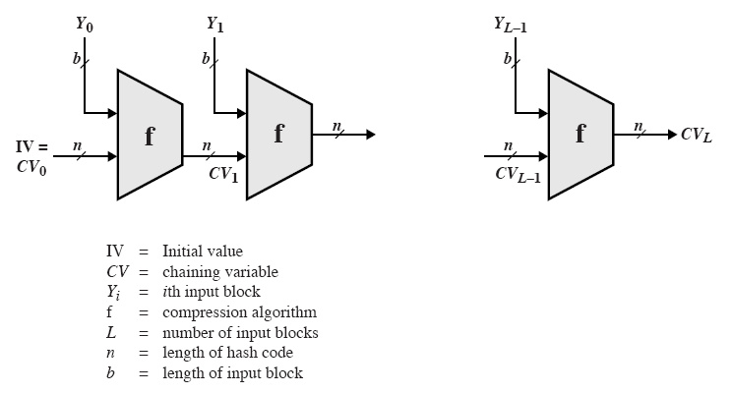
General Structure of Secure Hash Code
Iterative compression function
  Each f is collision-resistant, so is the resulting hashing

Slide 17

MD5: Message Digest Version 5
input Message
Output 128 bits Digest
Until recently the most widely used hash algorithm
  in recent times have both brute-force & cryptanalytic concerns
Specified as Internet standard RFC1321

Slide 18
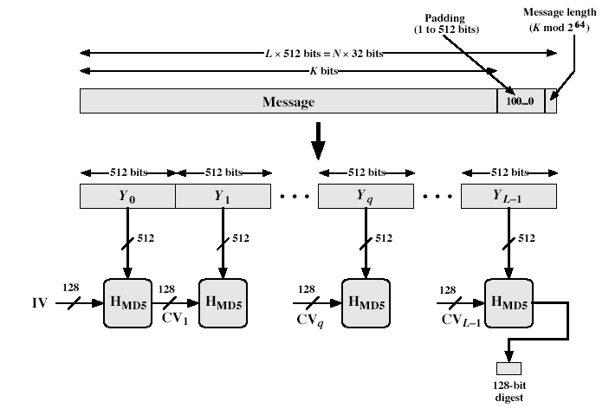
MD5 Overview
Notes:
Stallings Fig 12.1

Slide 19
MD5 Overview
Pad message so its length is 448 mod 512
Append a 64-bit original length value to message
Initialise 4-word (128-bit) MD buffer (A,B,C,D)
Process message in 16-word (512-bit) blocks:
  Using 4 rounds of 16 bit operations on message block & buffer
  Add output to buffer input to form new buffer value
Output hash value is the final buffer value
Notes:
The padded message is broken into 512-bit blocks, processed along with the buffer value using 4 rounds, and the result added to the input buffer to make the new buffer value. Repeat till run out of message, and use final buffer value as hash. nb. due to padding always have a full final block (with length in it).

Slide 20
Processing of Block m_{i} - 4 Passes
m_{i}
MD_{i}
ABCD=f_{F}(ABCD,m_{i},T[1..16])
A
B
C
D
ABCD=f_{G}(ABCD,m_{i},T[17..32])
ABCD=f_{H}(ABCD,m_{i},T[33..48])
ABCD=f_{I}(ABCD,m_{i},T[49..64])
+
+
+
+
MD _{i+1}

Slide 21
Padding Twist
Given original message M, add padding bits “10*” such that resulting length is 64 bits less than a multiple of 512 bits.
Append (original length in bits mod 2⁶⁴), represented in 64 bits to the padded message
Final message is chopped 512 bits a block

Slide 22
MD5 Process
As many stages as the number of 512-bit blocks in the final padded message
Digest: 4 32-bit words: MD=A|B|C|D
Every message block contains 16 32-bit words: m₀|m₁|m₂…|m₁₅
  Digest MD₀ initialized to: A=01234567,B=89abcdef,C=fedcba98, D=76543210
  Every stage consists of 4 passes over the message block, each modifying MD
Each block 4 rounds, each round 16 steps

Slide 23
Different Passes...
Each step i (1 <= i <= 64):
Input:
  m_{i} – a 32-bit word from the message
  With different shift every round
  T_{i} – int(2³² * abs(sin(i)))
  Provided a randomized set of 32-bit patterns, which eliminate any regularities in the input data
  ABCD: current MD
Output:
  ABCD: new MD

Slide 24
MD5 Compression Function
Each round has 16 steps of the form:
  a = b+((a+g(b,c,d)+X[k]+T[i])<<<s)
a,b,c,d refer to the 4 words of the buffer, but used in varying permutations
  note this updates 1 word only of the buffer
  after 16 steps each word is updated 4 times
where g(b,c,d) is a different nonlinear function in each round (F,G,H,I)
Notes:
Each round mixes the buffer input with the next "word" of the message in a complex, non-linear manner. A different non-linear function is used in each of the 4 rounds (but the same function for all 16 steps in a round). The 4 buffer words (a,b,c,d) are rotated from step to step so all are used and updated. g is one of the primitive functions F,G,H,I for the 4 rounds respectively. X[k] is the kth 32-bit word in the current message block. T[i] is the ith entry in the matrix of constants T. The addition of varying constants T and the use of different shifts helps ensure it is extremely difficult to compute collisions.

Slide 25
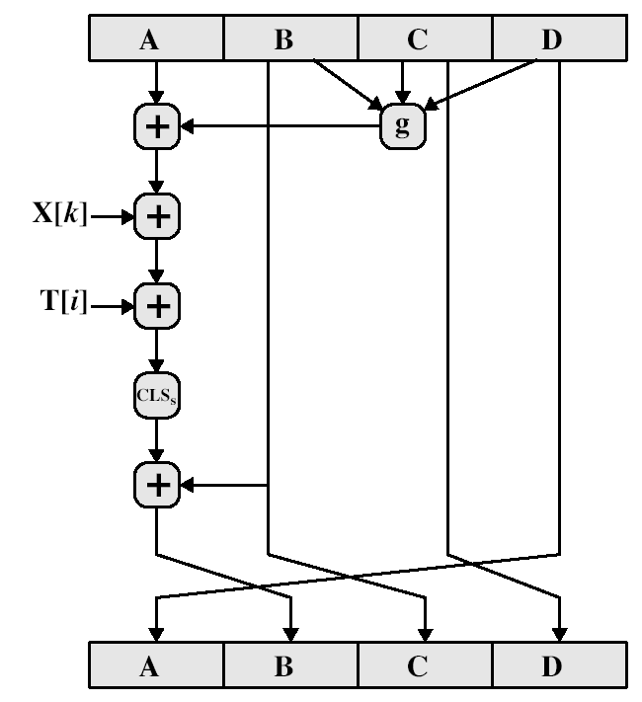
MD5 Compression Function

Slide 26
Functions and Random Numbers
F(x,y,z) == (x∧y)∨(~x ∧ z)
  selection function
G(x,y,z) == (x ∧ z) ∨(y ∧~ z)
H(x,y,z) == x⊕y⊕ z
I(x,y,z) == y⊕(x ∧ ~z)

Slide 27
Secure Hash Algorithm
Developed by NIST, specified in the Secure Hash Standard (SHS, FIPS Pub 180), 1993
SHA is specified as the hash algorithm in the Digital Signature Standard (DSS), NIST

Slide 28
General Logic
Input message must be < 2⁶⁴ bits
  not really a problem
Message is processed in 512-bit blocks sequentially
Message digest is 160 bits
SHA design is similar to MD5, a little slower, but a lot stronger

Slide 29
Basic Steps
Step1: Padding
Step2: Appending length as 64 bit unsigned
Step3: Initialize MD buffer 5 32-bit words
Store in big endian format, most significant bit in low address
  A|B|C|D|E
  A = 67452301
  B = efcdab89
  C = 98badcfe
  D = 10325476
  E = c3d2e1f0

Slide 30
Basic Steps...
Step 4: the 80-step processing of 512-bit blocks – 4 rounds, 20 steps each.
Each step t (0 <= t <= 79):
  Input:
    W_{t} – a 32-bit word from the message
    K_{t} – a constant.
    ABCDE: current MD.
  Output:
    ABCDE: new MD.

Slide 31
SHA-1 verses MD5
Brute force attack is harder (160 vs 128 bits for MD5)
A little slower than MD5 (80 vs 64 steps)
  Both work well on a 32-bit architecture
Both designed as simple and compact for implementation
Cryptanalytic attacks
  MD4/5: vulnerability discovered since its design
  SHA-1: no until recent 2005 results raised concerns on its use in future applications
Notes:
Compare using the design goals listed earlier.
In 2005, a research team described an attack in which two separate messages could be found that deliver the same SHA-1 hash using 2^69 operations, far fewer than the 2^80 operations previously thought needed to find a collision with an SHA-1 hash [WANG05]. This result should hasten the transition to newer, longer versions of SHA.
In August 2005, an improved attack on SHA-1, discovered by Xiaoyun Wang, Andrew Yao and Frances Yao, was announced at the CRYPTO conference rump session. The time complexity of the new attack is claimed to be 263. But no collision on SHA-1 has been found yet.

Slide 32
Revised Secure Hash Standard
NIST have issued a revision FIPS 180-2 in 2002
Adds 3 additional hash algorithms
SHA-256, SHA-384, SHA-512
  Collectively called SHA-2
Designed for compatibility with increased security provided by the AES cipher
Structure & detail are similar to SHA-1
Hence analysis should be similar, but security levels are rather higher
Notes:
See Stallings Tables 12.3 and 12.4 for details.

